Slide 1
ELECTRONIC DEVICES
COURSE INSTRUCTOR:
UMANG RAJ PANDEY

Slide 2
Zener diode
It is a special type of diode which works in breakdown region.
It acts as simple diode when forward biased(current flows from anode to cathode).
But when operated in reverse breakdown they have extremely stable breakdown voltage over wide range of current levels.
So they are considered as the backbone of voltage regulator.

Slide 3
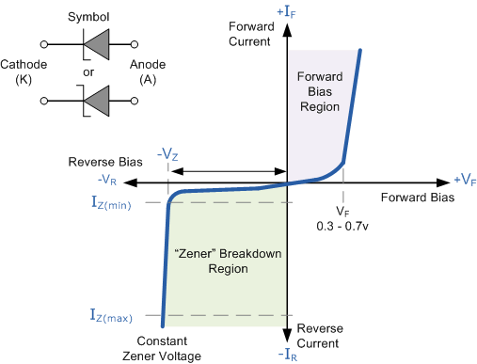

Slide 4
Applications
As a voltage regulator
As clippers in wave shaping circuits
Fixed reference voltage in transistor biasing circuits

Slide 5
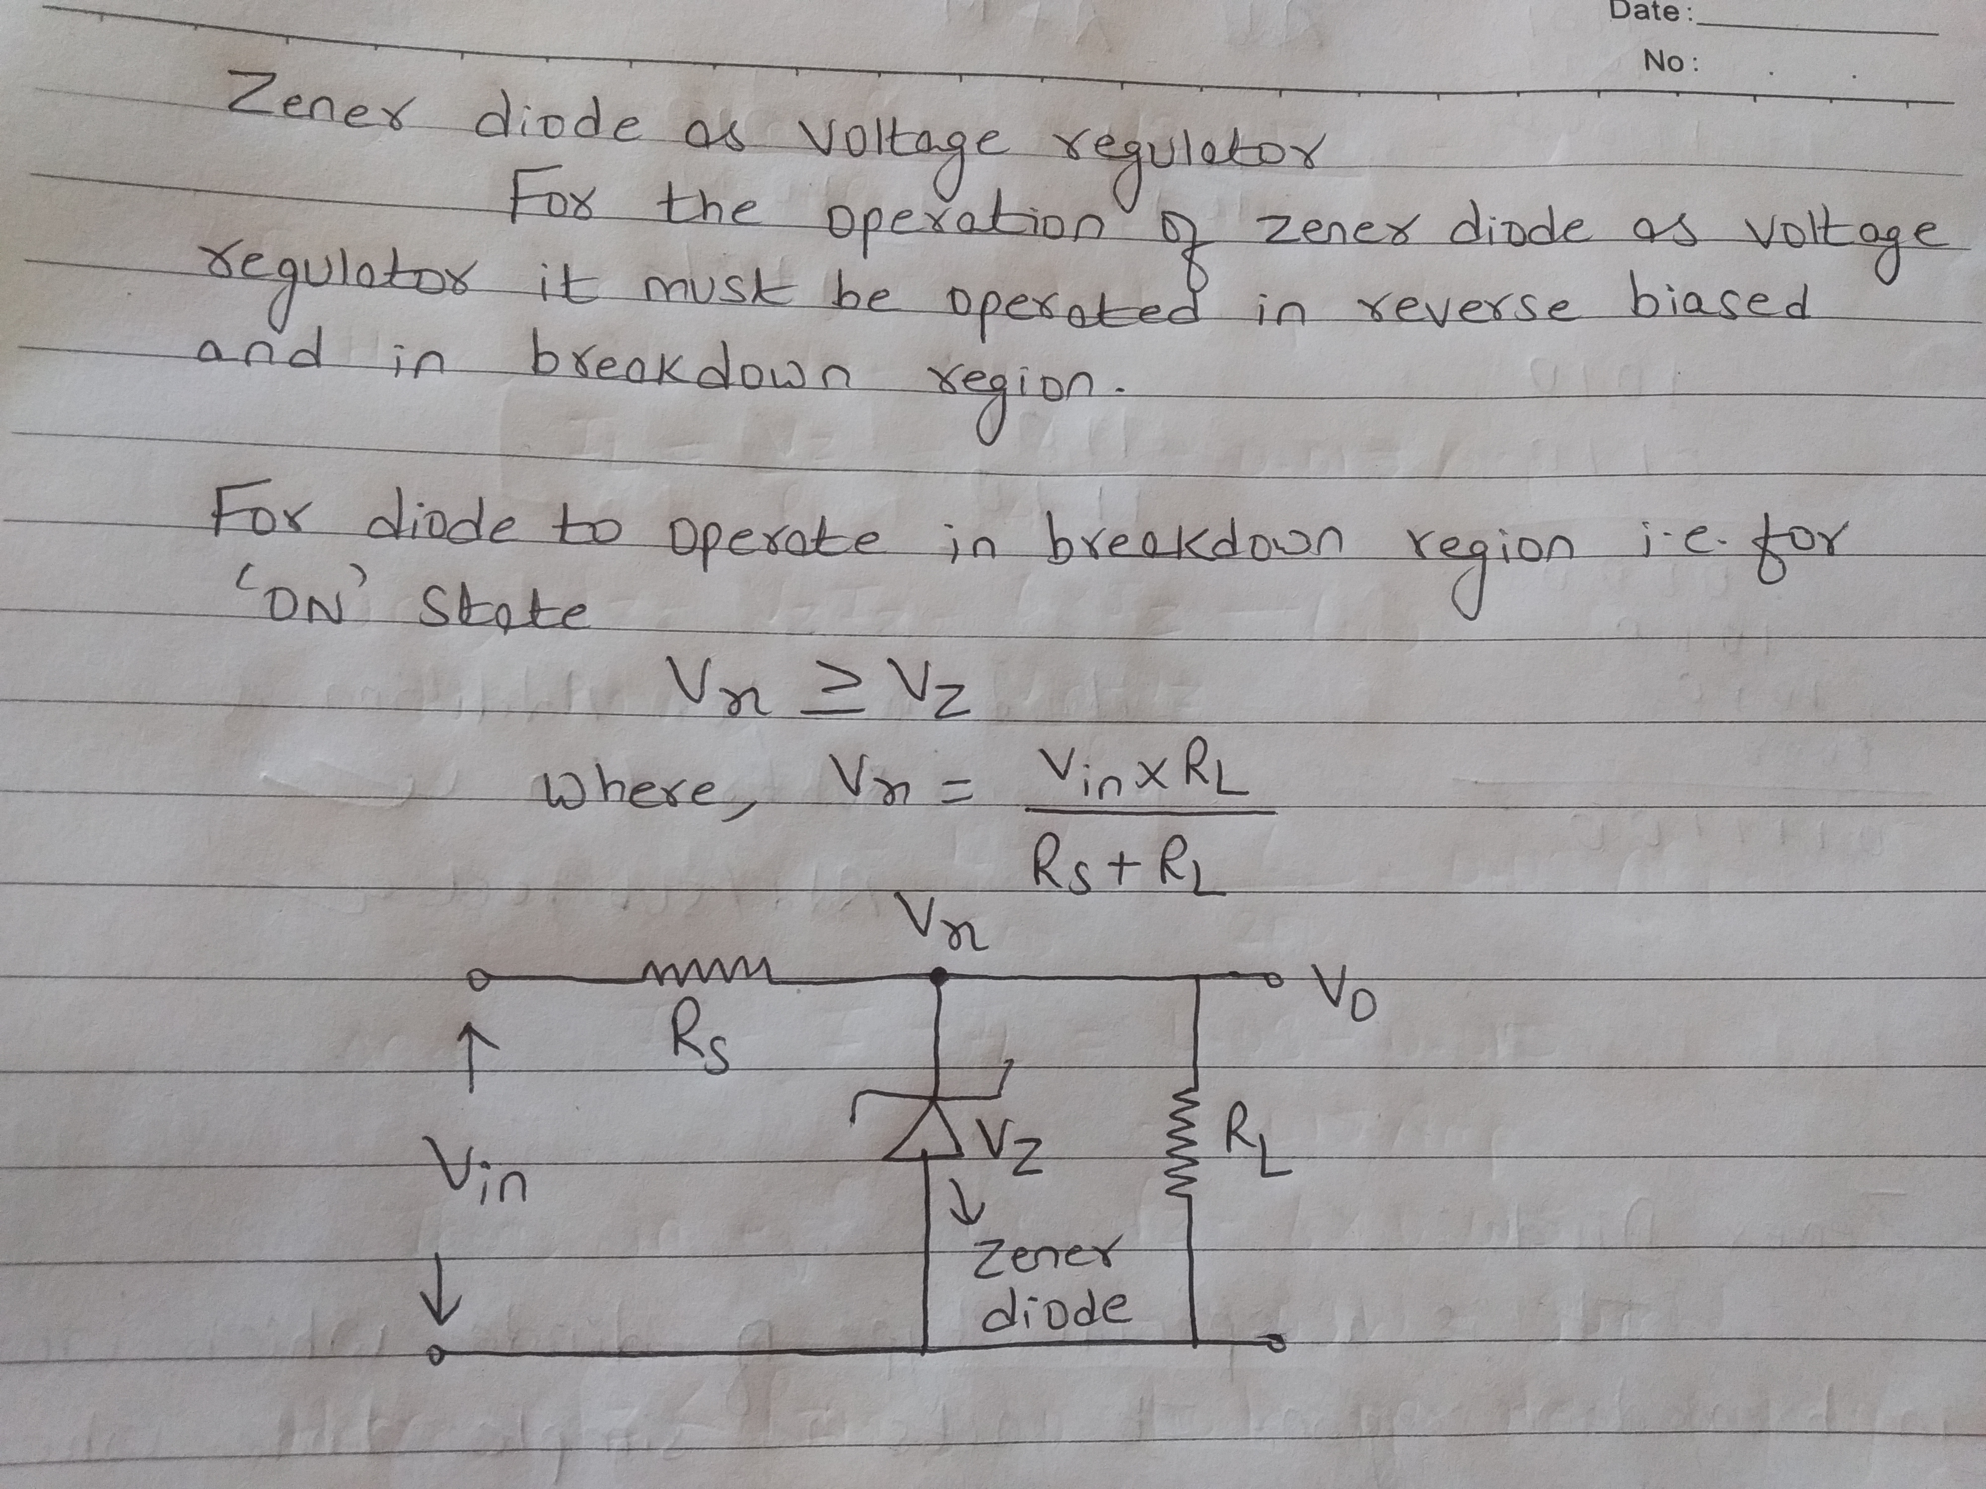

Slide 6
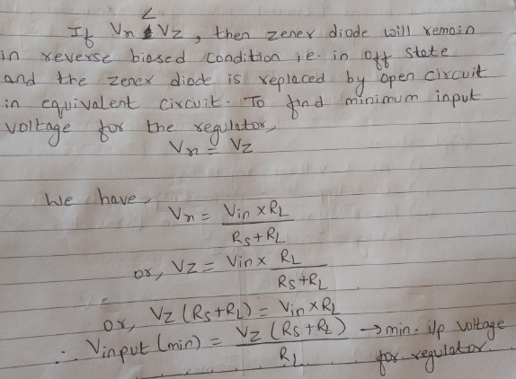

Slide 7
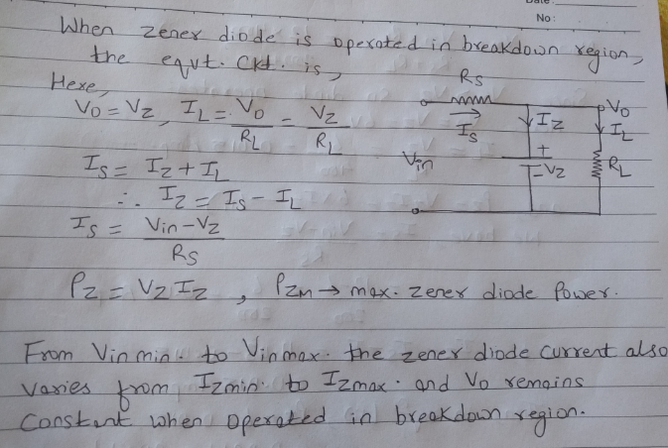

Slide 8
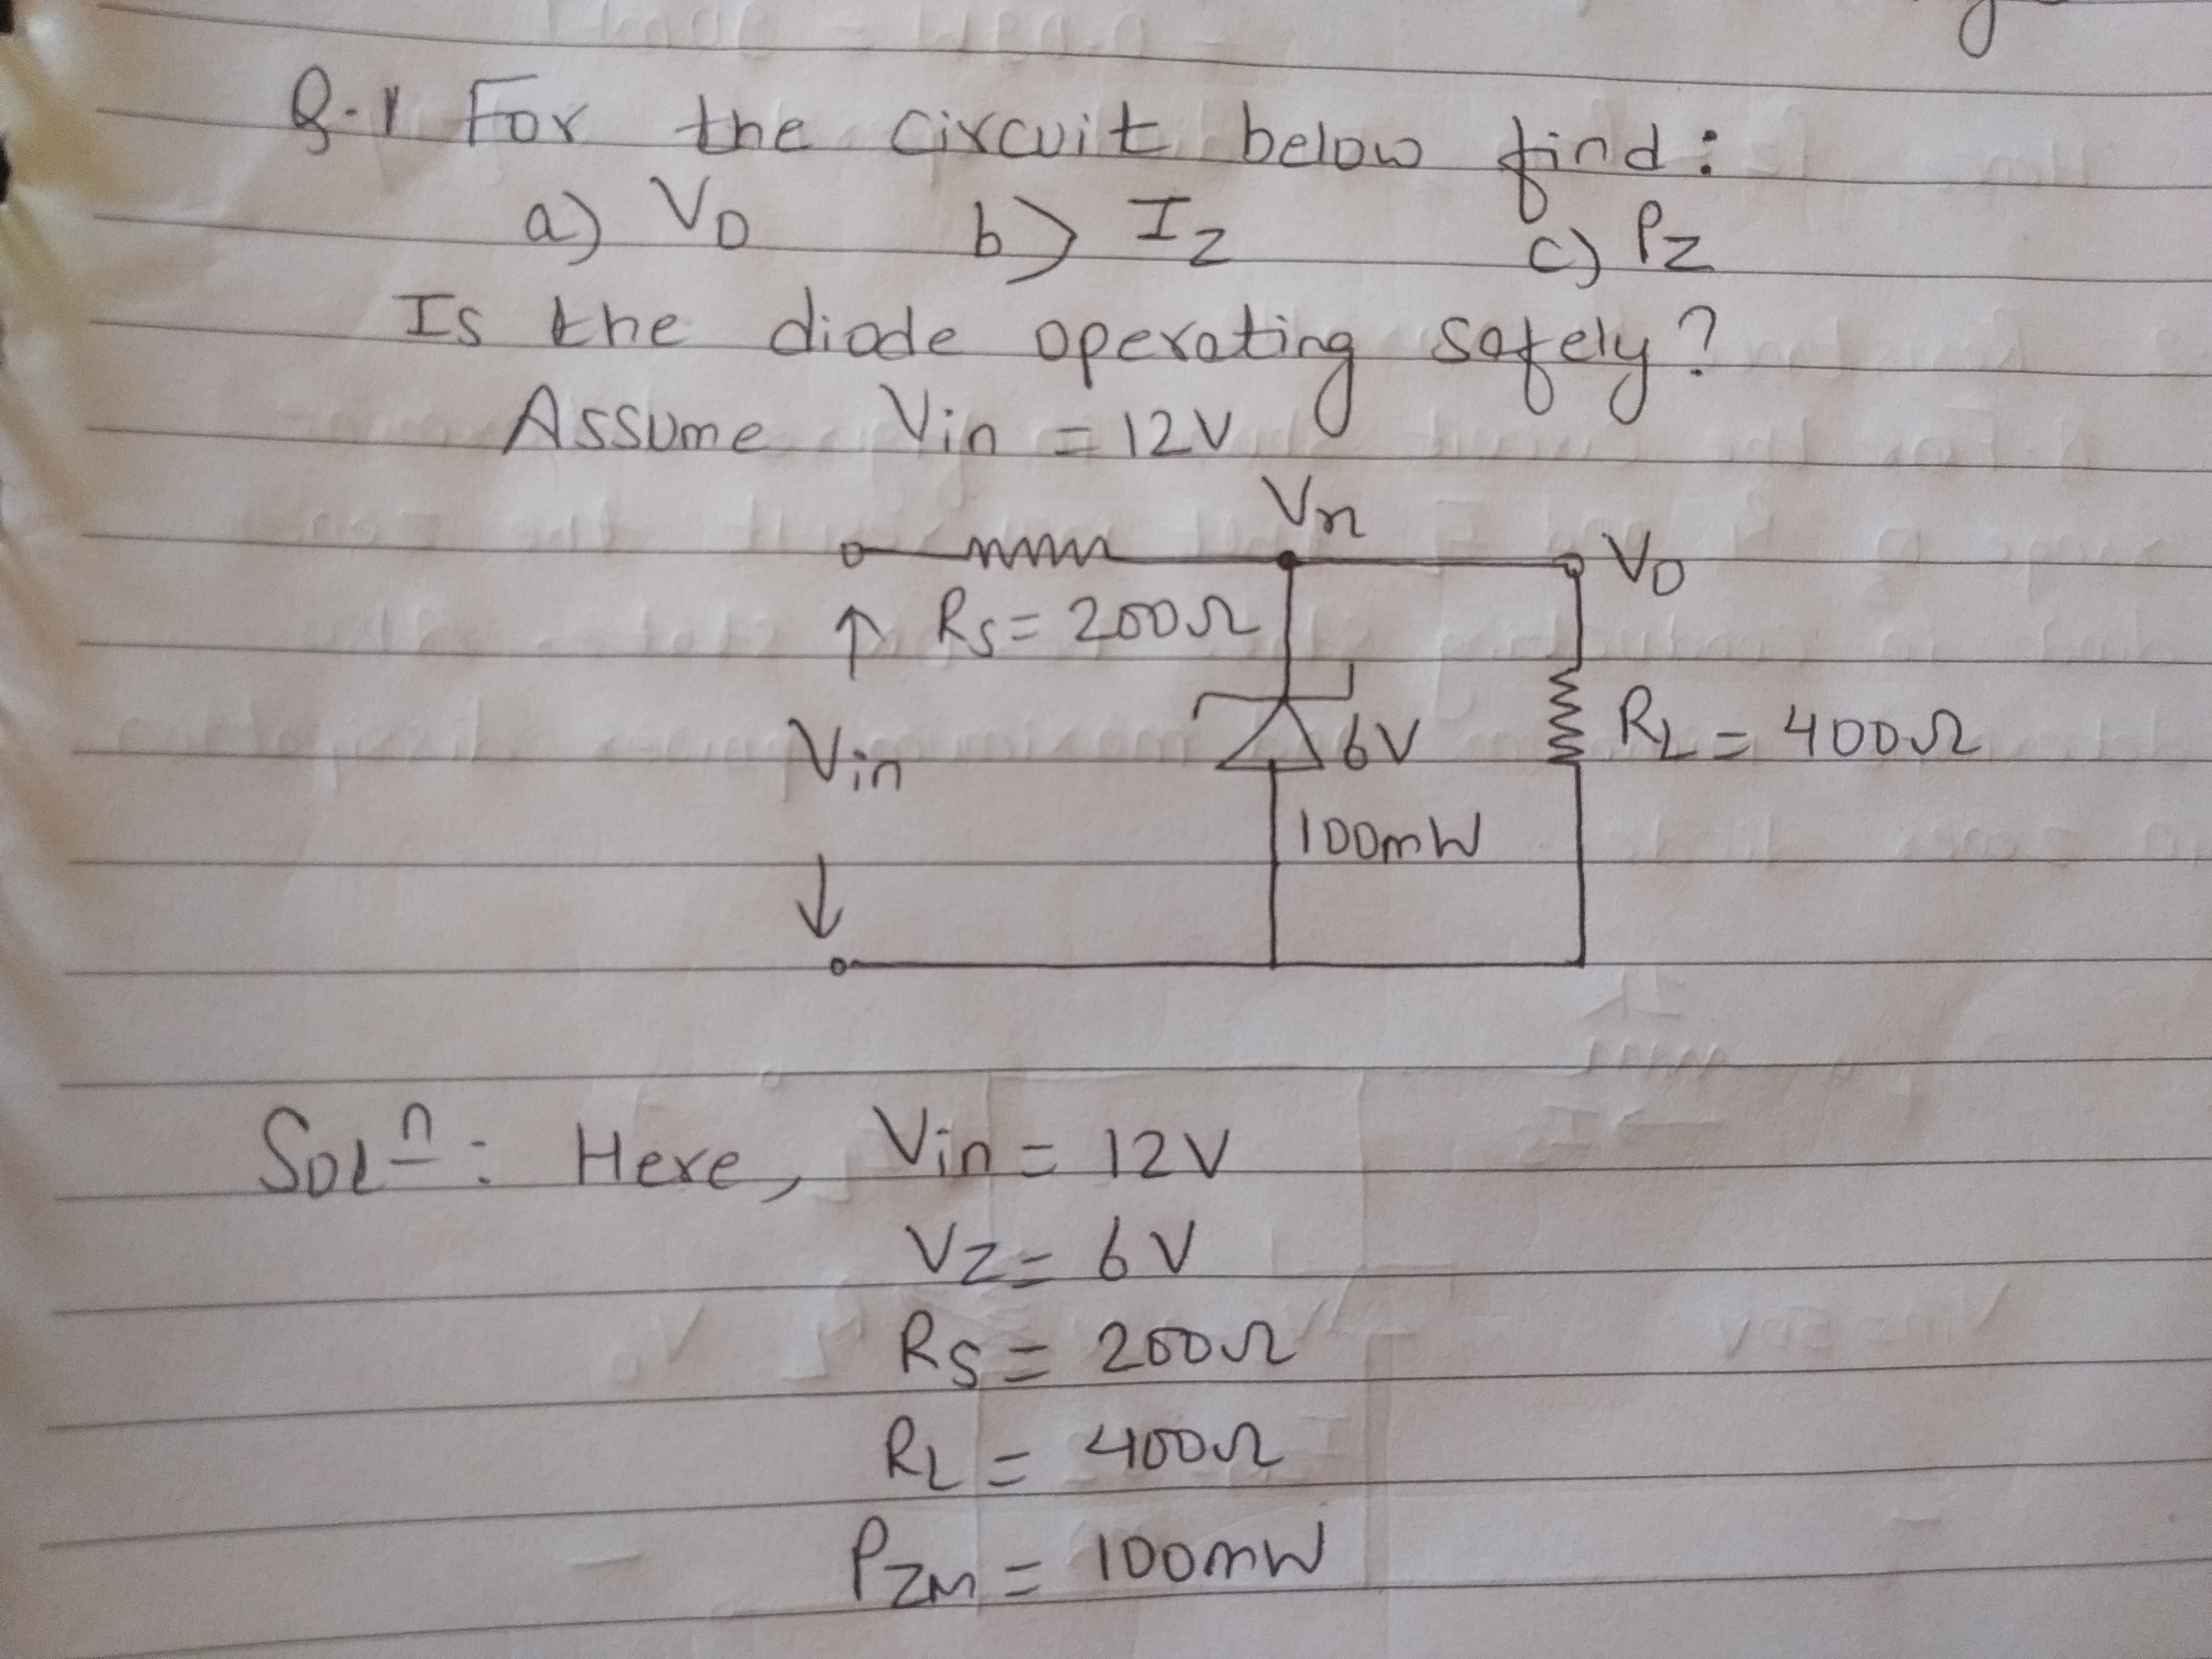

Slide 9
